Slide 1
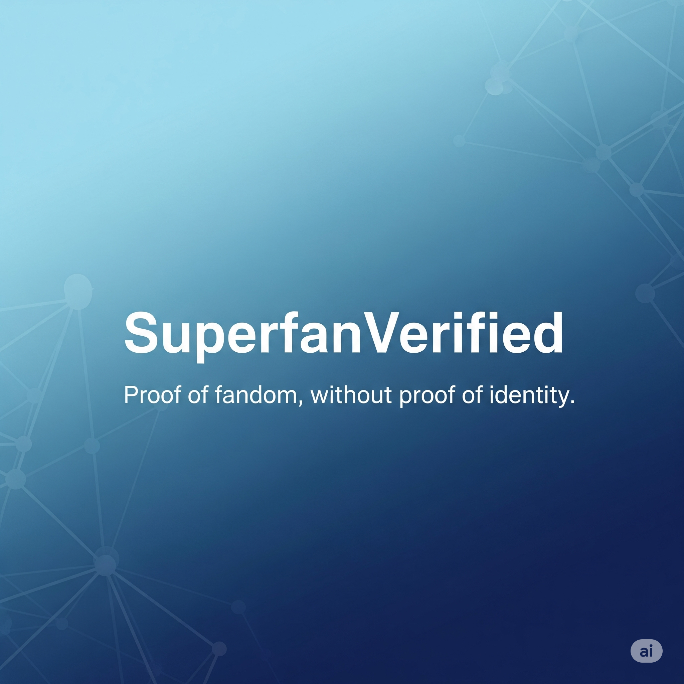

Slide 2


Revolutionizing Fan Engagement with SuperfanVerified
SuperfanVerified is set to transform how fans connect with creators by offering verifiable proof of fandom while prioritizing user privacy. Leveraging innovative technology, we foster authentic relationships between creators and their genuine fans, ensuring a deeper and more meaningful engagement. Join us in creating a new era of fan experience.

Slide 3



Challenges in Fan Engagement Recognition
The engagement gap between fans and creators is increasingly evident. Without a reliable method to showcase loyalty, creators struggle to reward genuine supporters, leading to a disconnect. Additionally, privacy concerns around data tracking make fans reluctant to share their engagement stats.
Lack of Reliable Engagement
Creators' Recognition Issues
Privacy Concerns
Fans currently lack a reliable way to demonstrate their engagement across various platforms.
Creators face challenges in recognizing their most dedicated fans.
Centralized tracking raises significant privacy concerns for fans.

Slide 4



Enhancing Fan Engagement with Privacy
Built on Secure Protocols
2
Utilizes the Reclaim Protocol and zkTLS for data privacy.
Zero-Knowledge Proofs
Verify fan activities without exposing personal information.
1
Empowered User Sharing
3
Share fandom credentials without compromising identity.

Slide 5
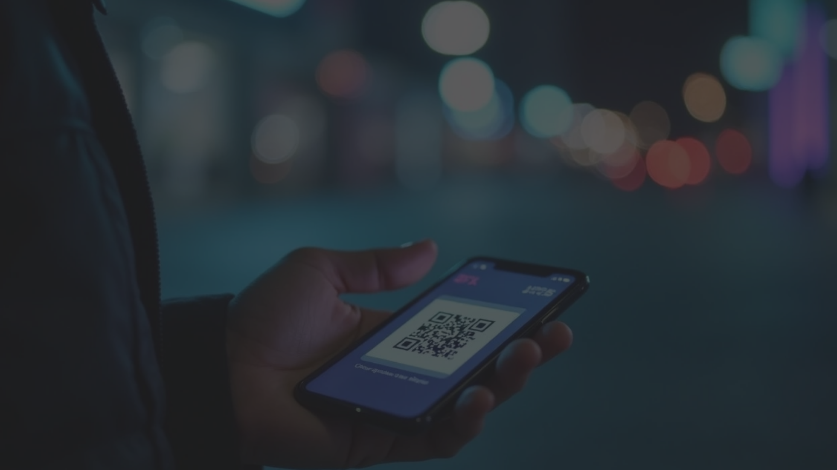


How It Works
Connect Wallets
Scan Codes
Users connect their digital wallets using WalletConnect, streamlining the authentication process securely.
The app scans QR codes or fetches data directly from various platforms, making it easy for users to gather proof of engagement.
Generate Proof
Enhance Trust
A zk-proof of engagement is generated, which users can share with creators or communities for verification.
This proof is not only shareable but also verifiable, enhancing trust within the fan community.

Slide 6
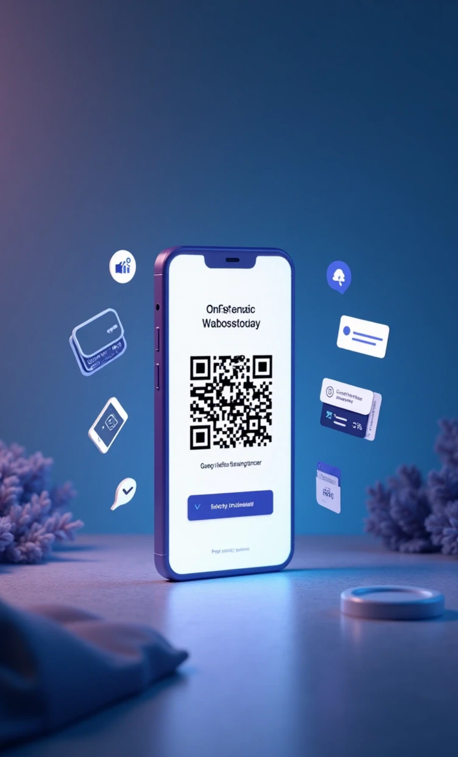



Demo Screenshots of Onboarding Process
1
Onboarding Process
2
QR Code Scanning
Easy wallet connection and app engagement.
Seamless data collection interaction.
3
Proof Generation
4
Wallet Integration
User-friendly notifications and confirmations.
SQLite for data management and Sentry for error tracking.

Slide 7





Use Cases in Various Industries
Music Industry
1
2
Gaming
Verifying concert attendance for insights on fan engagement.
Proof of leaderboard rankings to reward top players effectively.
Fitness Challenges
Education
Validation of challenges to motivate participants and promote health.
Verification of course completion to enhance online learning credibility.
4
3

Slide 8



Market Opportunity in Creator Economy
Valuation of Creator Economy
Emerging Web3 Tools
Privacy-First Applications
The creator economy is valued at over $250 billion, indicating a substantial market for tools that facilitate engagement and monetization.
Emerging Web3 fan engagement tools highlight a growing demand for decentralized solutions that prioritize user privacy.
Privacy-first applications are gaining traction, as users increasingly value their data security and control over personal information.

Slide 9
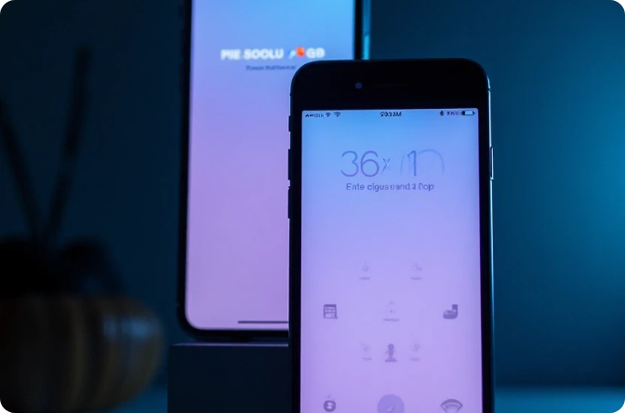

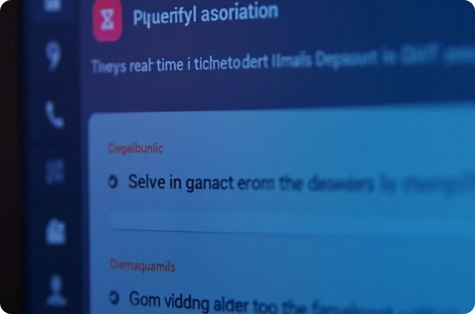

Tech Stack Overview
Cross-Platform Framework
Secure Wallet Connections
Built using React Native and Expo for seamless experience.
Utilizing WalletConnect for secure wallet integrations.
Error Tracking
Enhanced Security
Sentry is used for real-time error tracking and fast resolutions.
Leveraging zkTLS and Reclaim Protocol for verifiable credentials.

Slide 10



SuperfanVerified Vision
2
Expanding Services
The platform plans to expand its services to brands, communities, and events, enhancing engagement opportunities across various sectors.
Leading Platform
SuperfanVerified aims to become the leading platform for proof-of-participation, bridging the gap between fans and creators.
1
User Privacy Focus
By prioritizing user privacy and security, SuperfanVerified seeks to empower fans and creators alike.
3

Slide 11

Join Us in Redefining Fandom
Engaged Community
Recognize Support
Explore Our Project
Join us in redefining fandom and creating a more engaged community.
Where fans are recognized for their unwavering support.
Visit our GitHub repository to explore our project further.

